Slide 1

League of Analysis
Christine Li, Ludan Zhang, Ramon Faylona, Ryan Apolonio

Slide 2
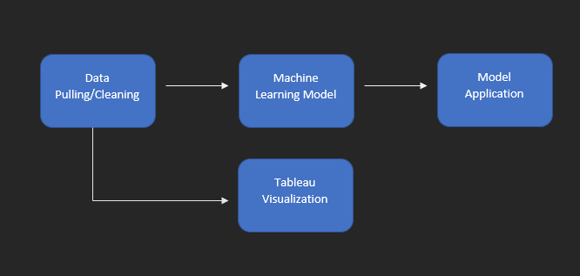
Our project
What variables are most important to winning the game?
Pull 100 games from a player of each rank (9 players total) using RiotWatcher library
Limitations: Only pulled from CLASSIC gamemode
Could not get a developer key
Clean the data and select optimal variables
Create a model that can predict whether a player won or lost a game
Visualize the data using Tableau

Slide 3



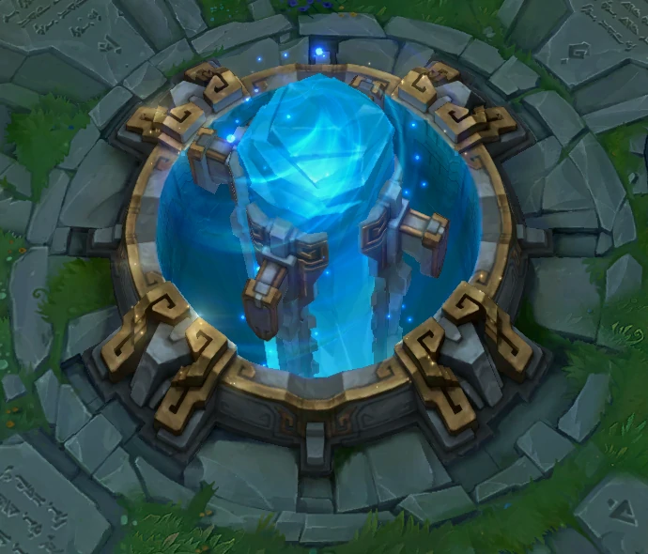
How the game works
Champion
Gold
Play as a champion, 5 vs 5
Kill other players
Gain gold
Buy items to make you stronger
Destroy their base/nexus
Item
Nexus

Slide 4
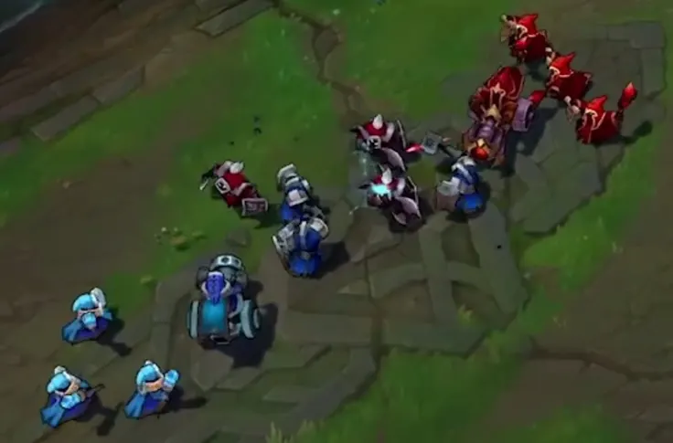

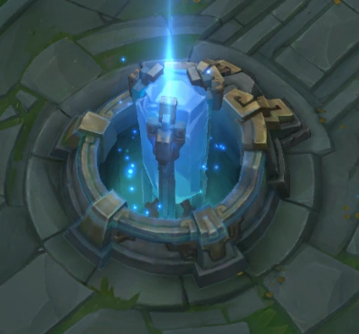

Other explanations
KDA = (Kill + Assist) / Death
Minions
Baron Buff
Inhibitors
Rank system
Minions
Baron
Inhibitor
Ranks

Slide 5
Data Pulling / Cleaning

Slide 6
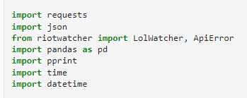
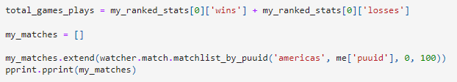
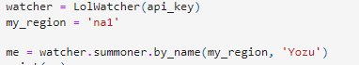
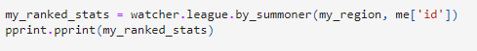
Data pulling/cleaning

Slide 7
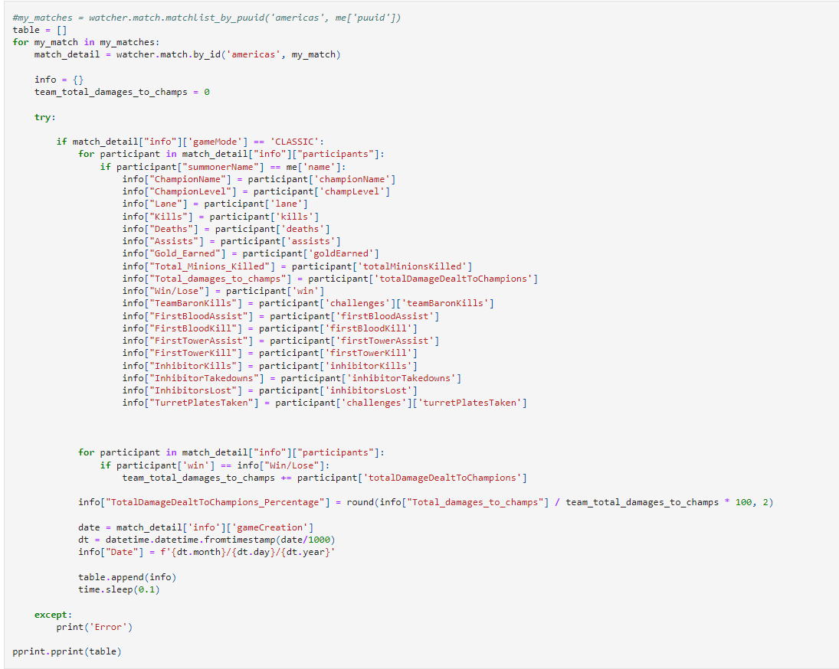
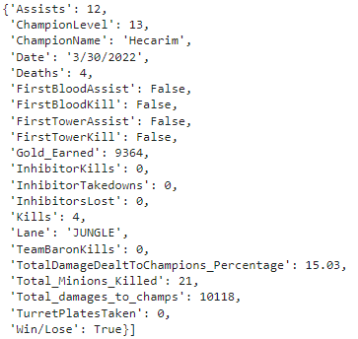
Data pulling/cleaning

Slide 8
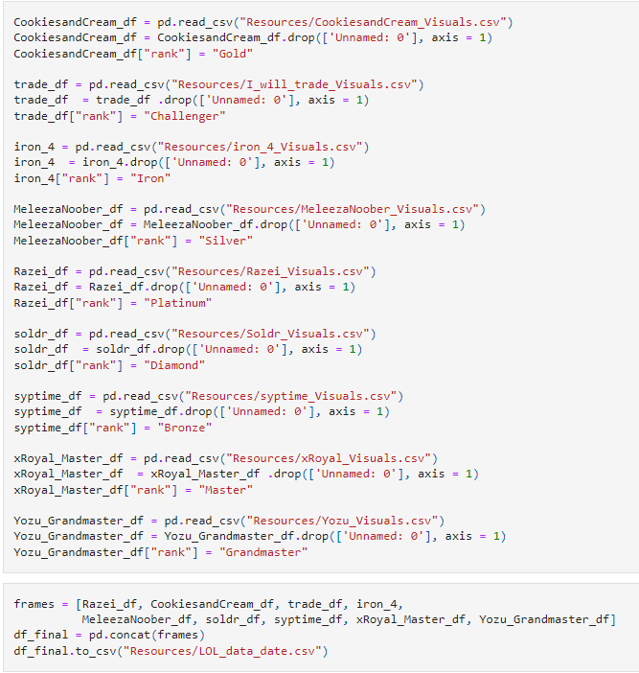
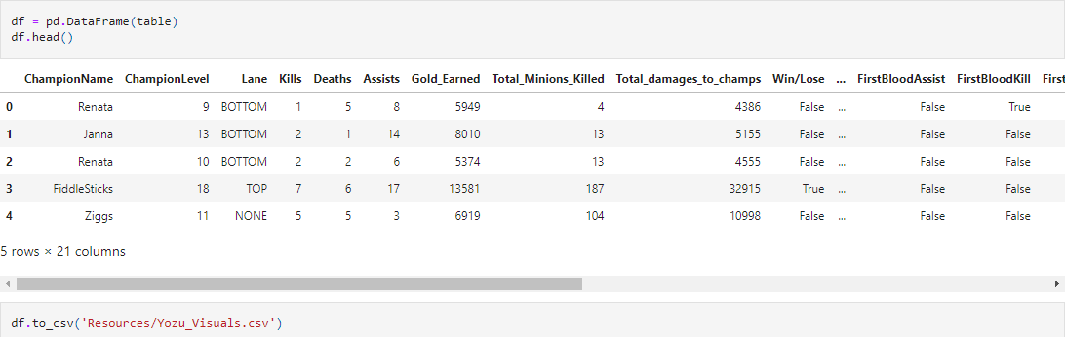
Data pulling/cleaning

Slide 9
Machine Learning Model

Slide 10
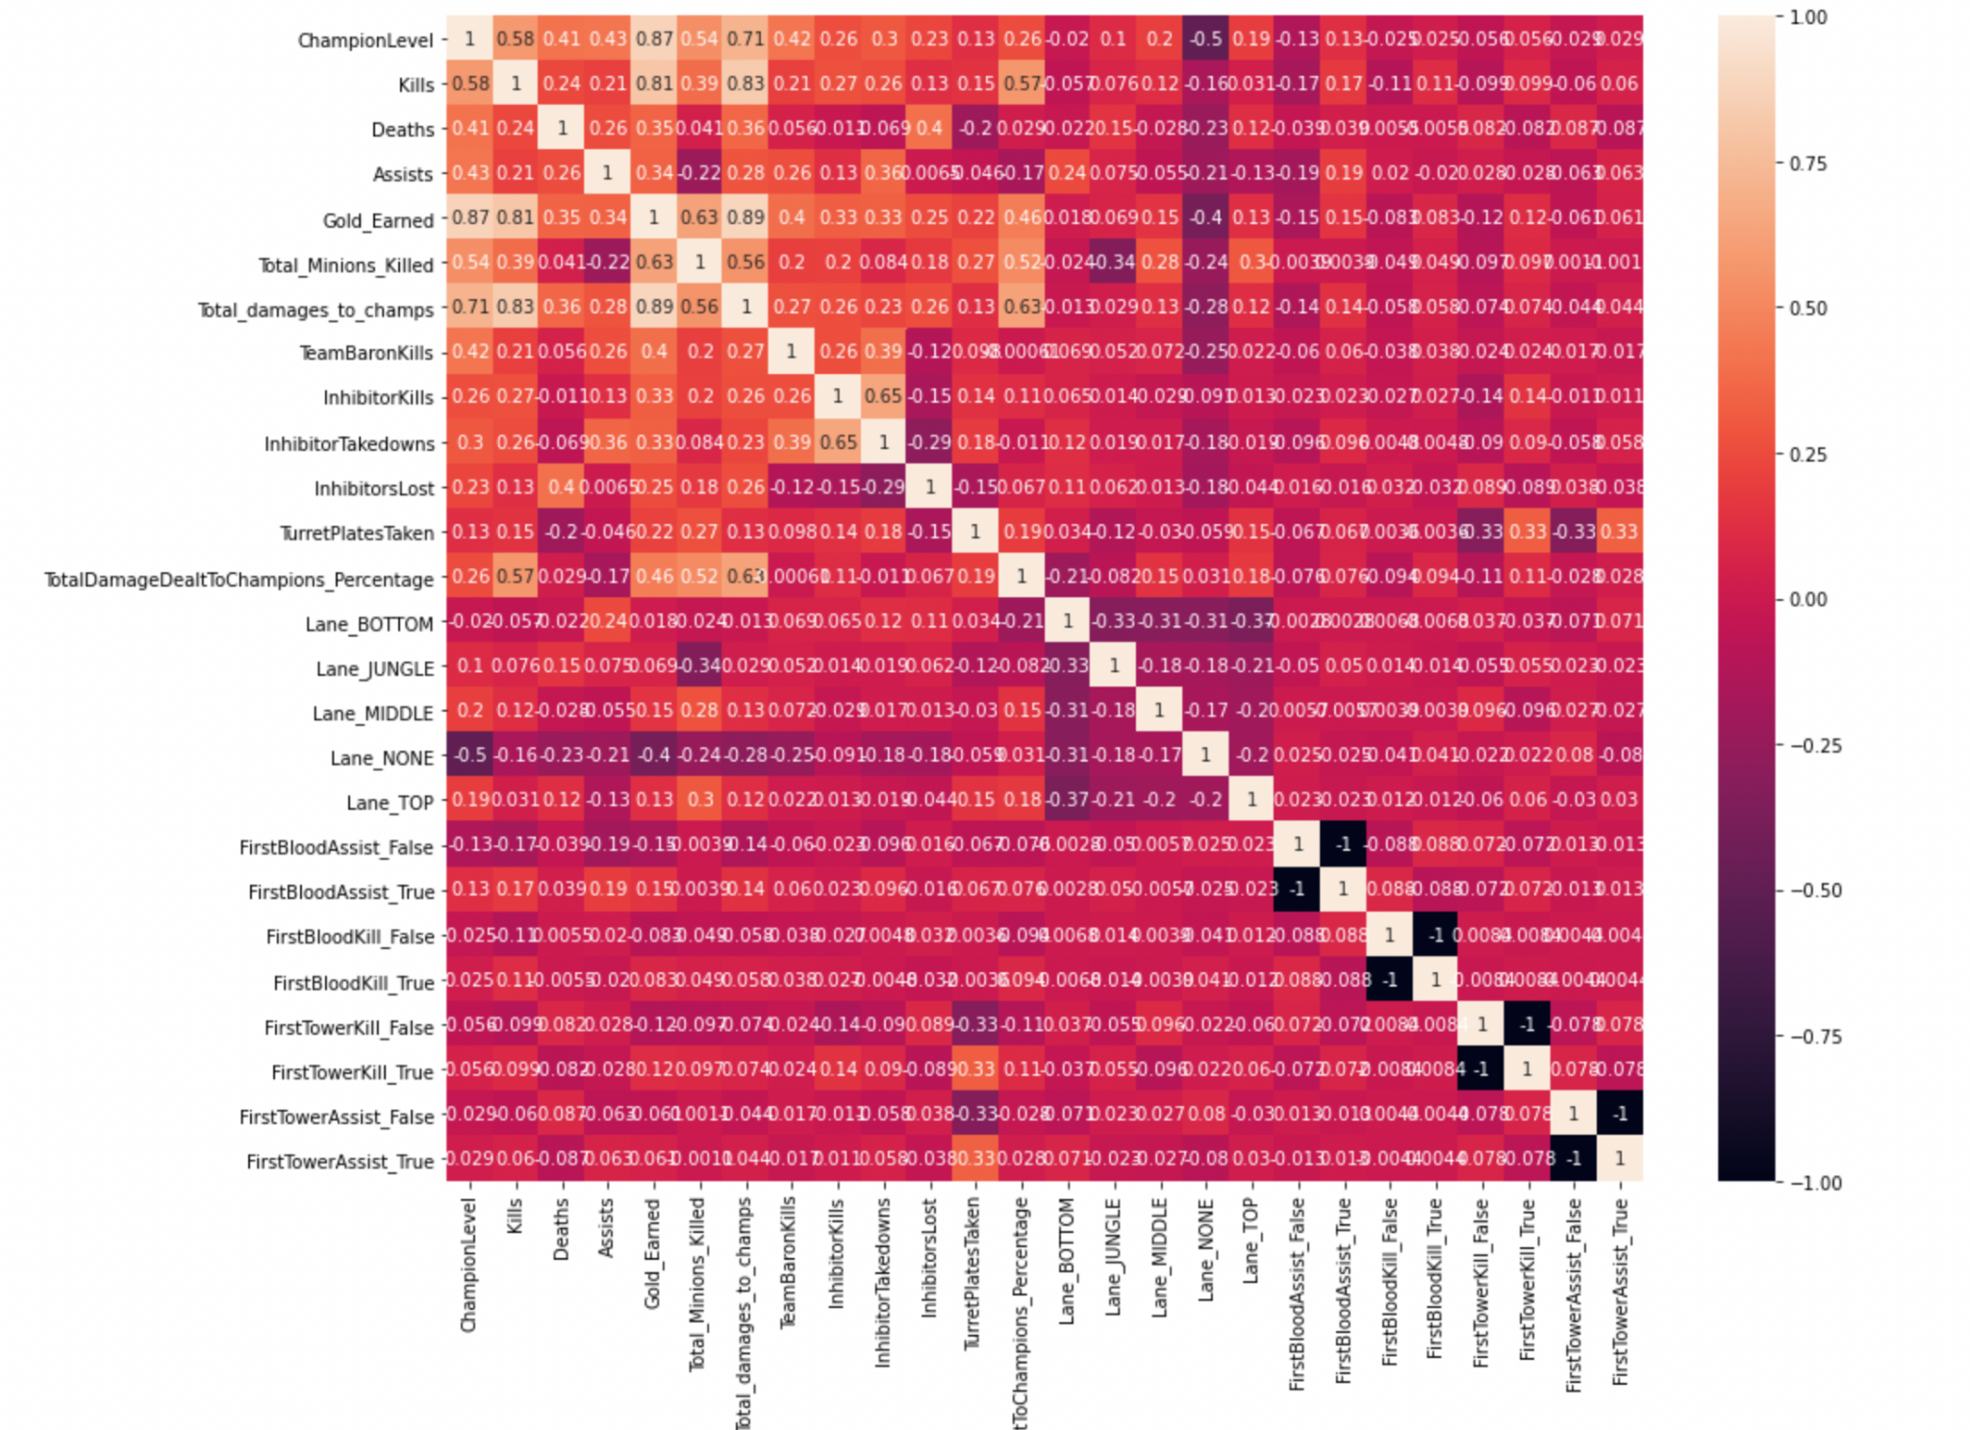
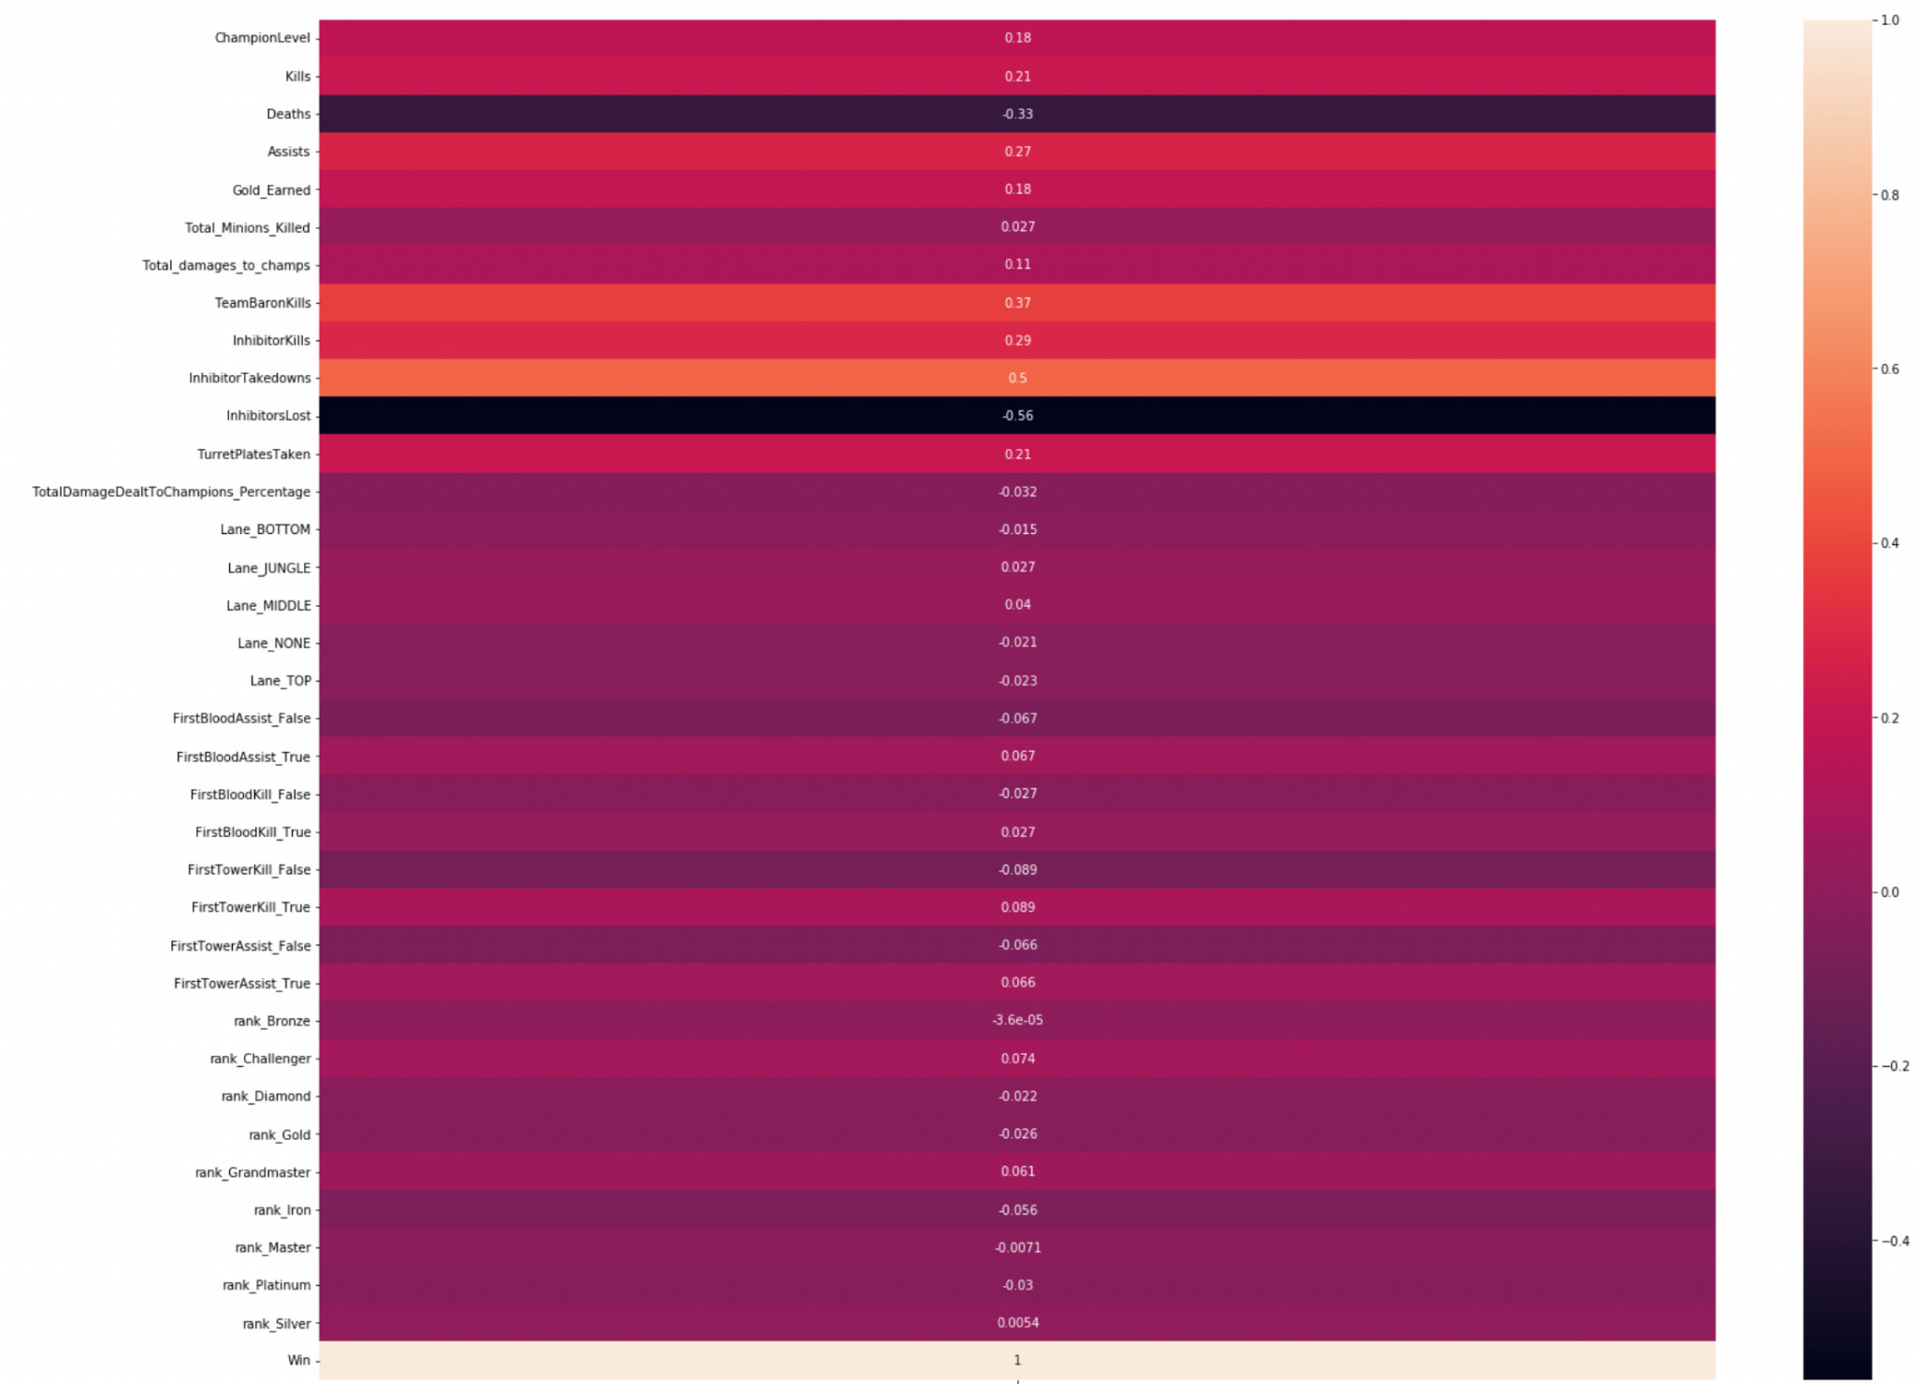
Data Preview (Correlation Matrix)

Slide 11
Logistic Regression
Objective: With the collected game information (players’ rank, performance data), we want to predict the chance of winning of each game. Since the response variable is binary, we use Logistic Regression.
Process:
Data Transformation
Separate data into predictive variables and response variable
Create dummy variable
Training & Testing split
Fit Model
Statistic KPIs (Accuracy Rate, Confusion Matrix)

Slide 12
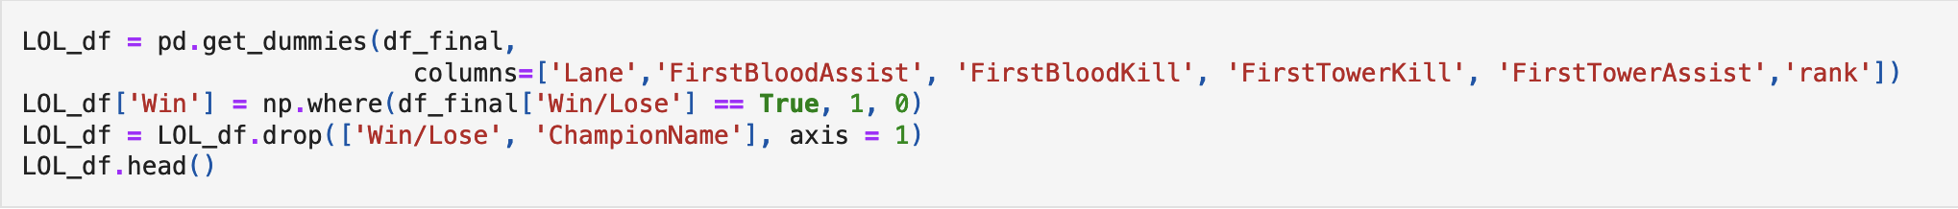
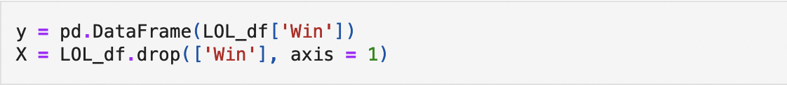
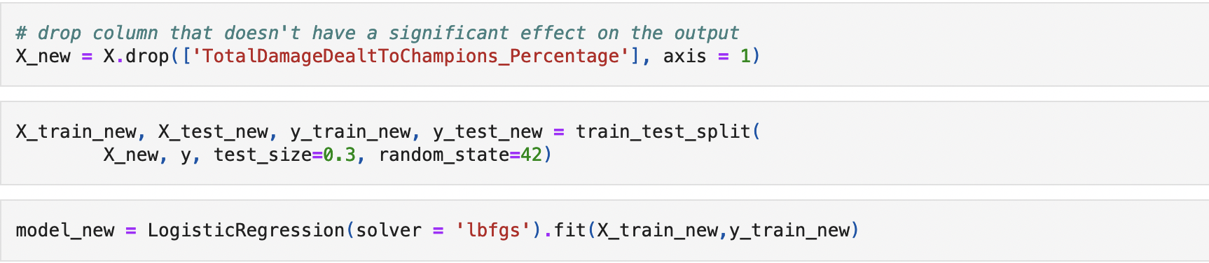
Data Preparation

Slide 13
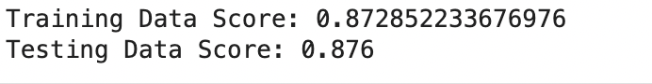
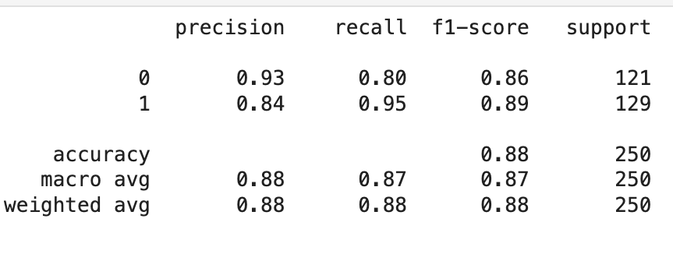
Statistics KPIs
Model Score:
Confusion Matrix:
Confusion Matrix Summary:
 | Prediction
Actual | Win | Not Win
Win | 97 | 24
Not Win | 7 | 122

Slide 14
Decision Tree & Random Forest
Objective: With the collected game information (players’ rank, performance data), we want to predict the chance of winning of each game. Decision Tree could provide useful insight for each segment.
Process:
Data Transformation
Separate data into predictive variables and response variable
Create dummy variable
Training & Testing split
Fit Model

Slide 15
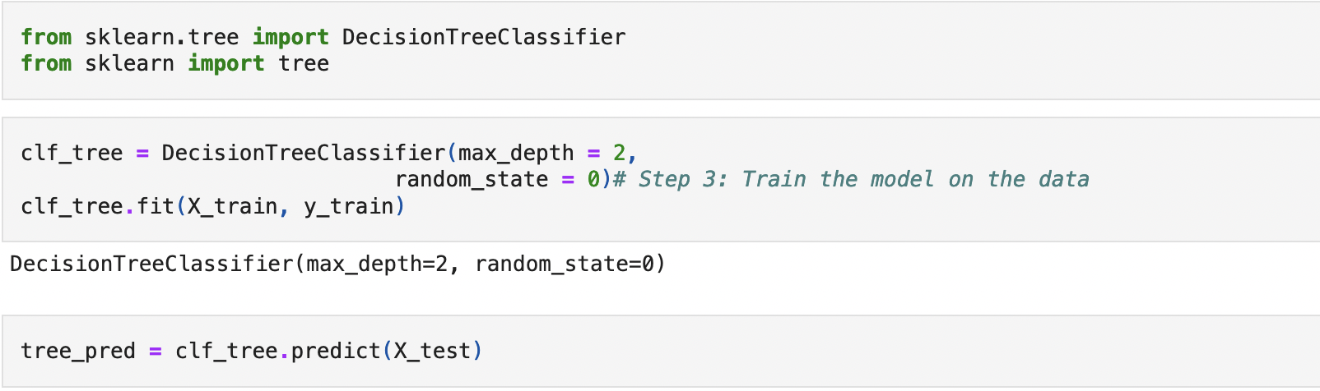
Data Preparation & Fit Model

Slide 16
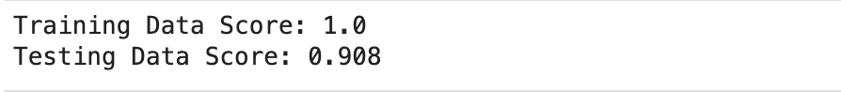
Statistics KPIs
Random Forest:
Decision Tree:
 | Prediction
Actual | Win | Not Win
Win | 103 | 18
Not Win | 5 | 124
 | Prediction
Actual | Win | Not Win
Win | 103 | 18
Not Win | 5 | 124

Slide 17
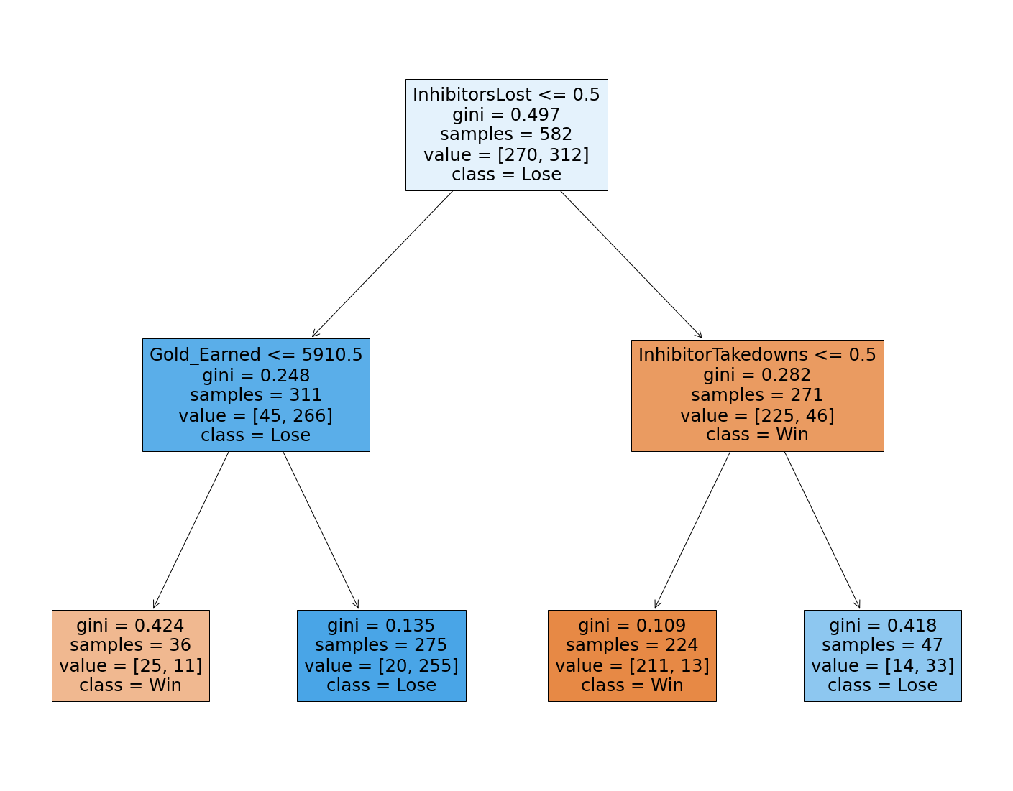
Tree Split Detail

Slide 18
Model Application

Slide 19
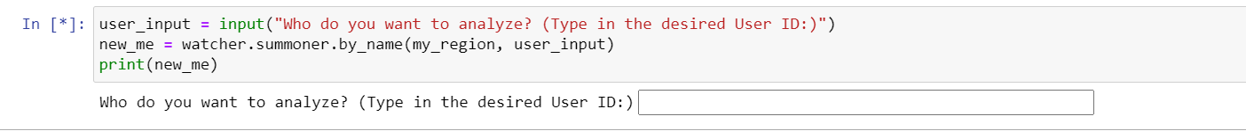
Game Prediction
Data Limitation: Data from live games is not available
Application of Regression Model:
Step 1: Pull last game data from any given user
Example: User ID = Evish

Slide 20
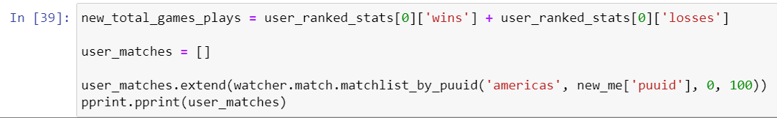
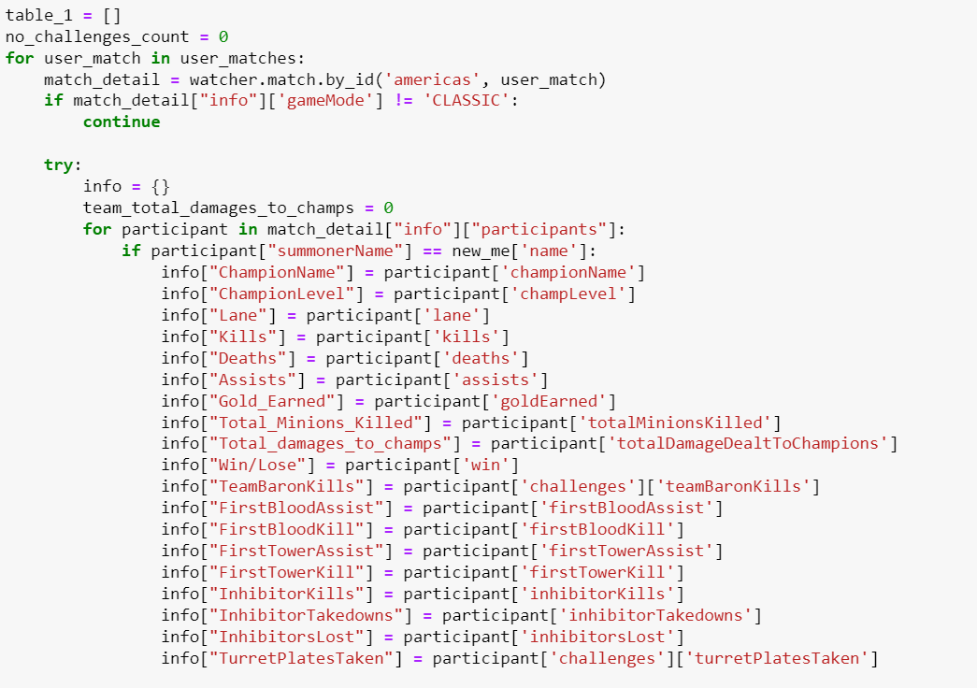
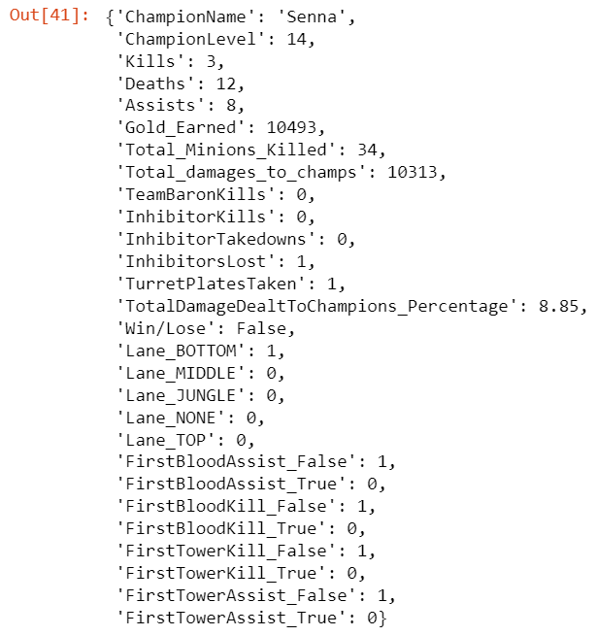
Game Prediction
Step 2: Pull user’s last match data

Slide 21
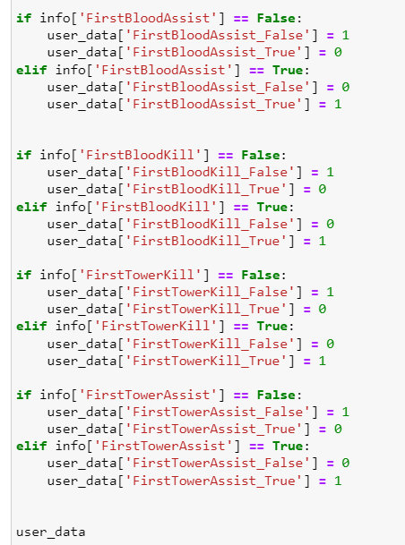
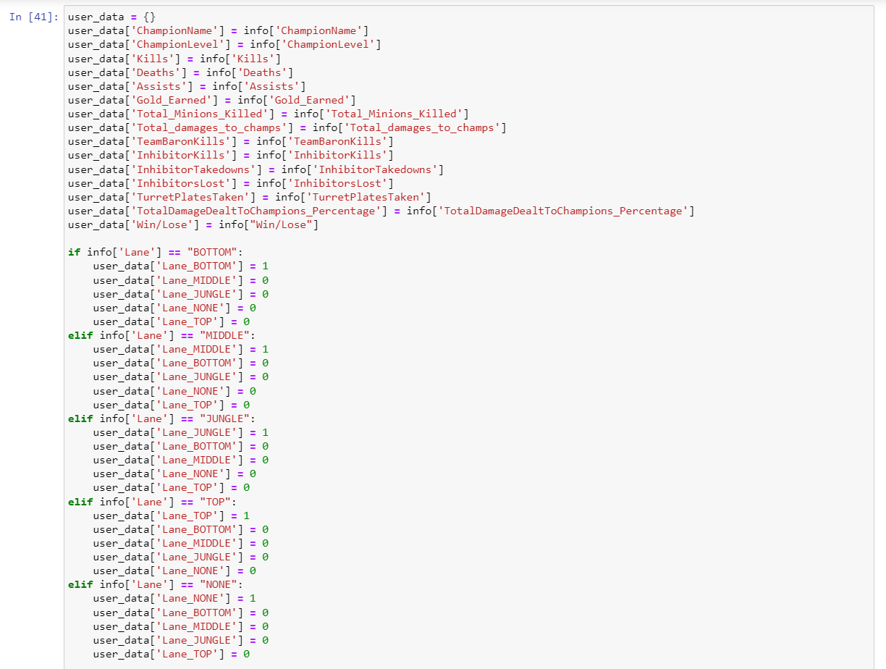
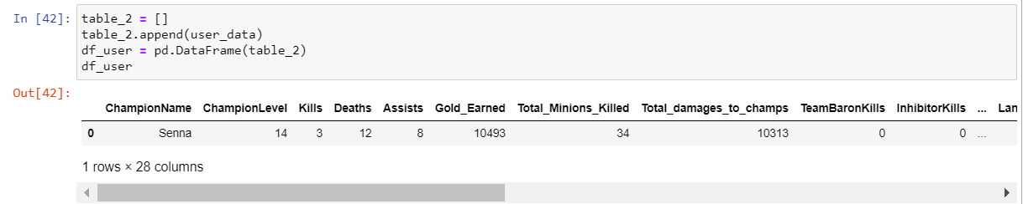
Game Prediction
Step 3: Data cleaning, structure variables the exact same way as the ones used in model and put the final clean data table into a data frame

Slide 22
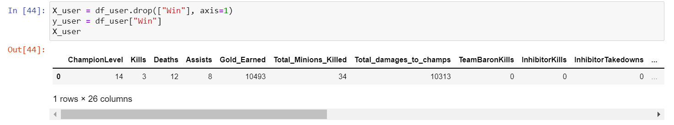
Game Prediction
Step 4: Group all 26 x variables together as x_user and the win/lose result (y variable) as y_user
Step 5: Plug x_user into our logistic regression model and get the predicted result as y_pred

Slide 23
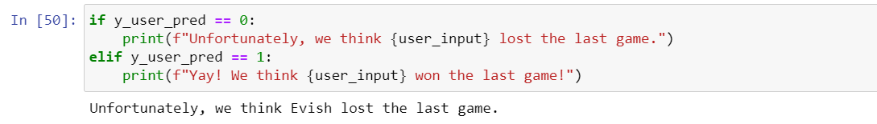
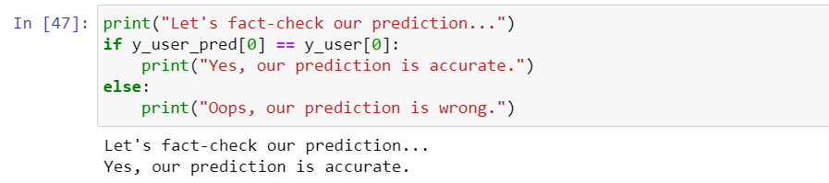
Game Prediction
Step 6: Print out our prediction on user’s last game result
Step 7: Run a fact-check on user’s last game result

Slide 24
Visualization Analysis

Slide 25


THANK YOU

